Slide 1
Spring Controllers & Services
Adding DTOs and Mappers

Slide 2
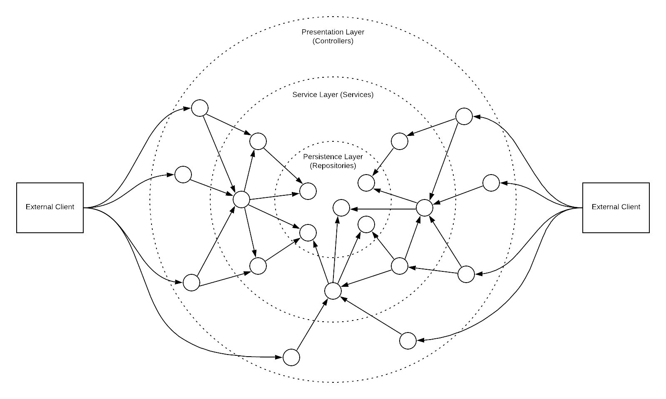
Onion Architecture

